Slide 1
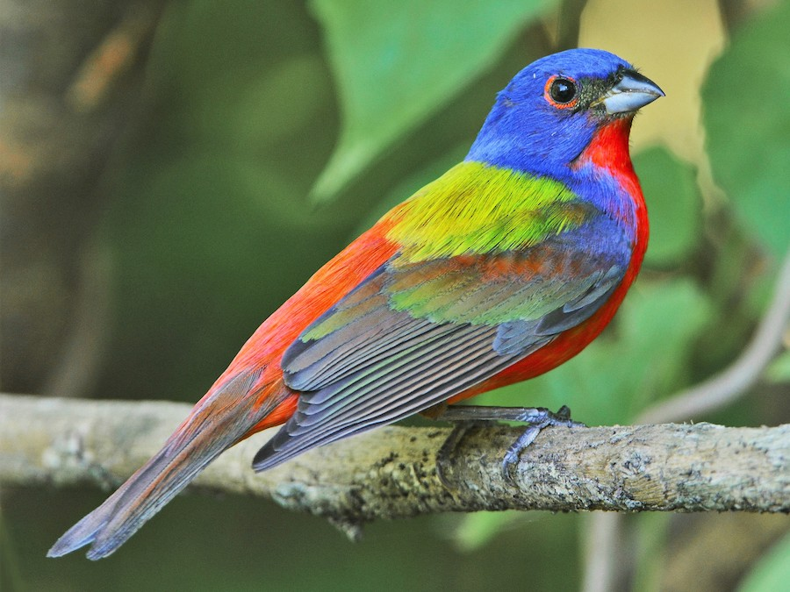
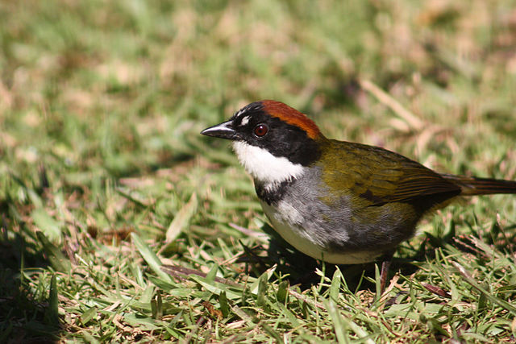
Ecosphere:
Life Events of Winter Birds
Collaboration by: Jodie Cheun, Jocelyn Morales, Pachia Lee
Notes:
When uploading the presentation to github, it will need to be in a PDF format. Make sure all the formatting is okay when turned into PDF

Slide 2
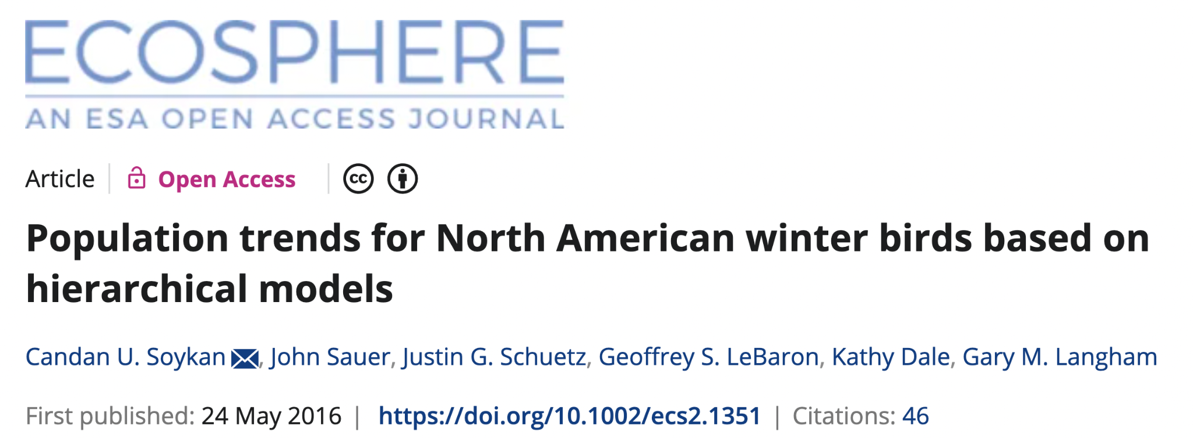
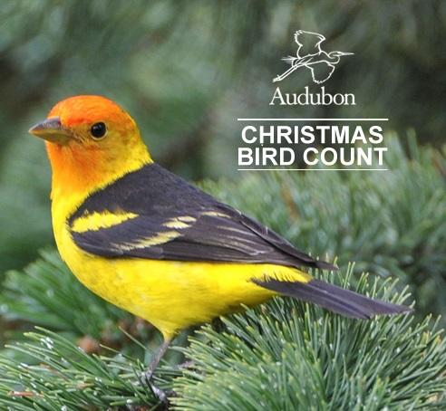
About our Data
CBC data from 1966 to 2013
Examined 10 biological traits of winter birds
Population dynamics
Location Abundance
Thank you Professor Ledford!
Notes:
Picture here is just a placeholder! We can totally change it to something more interesting, a few options online.

Slide 3
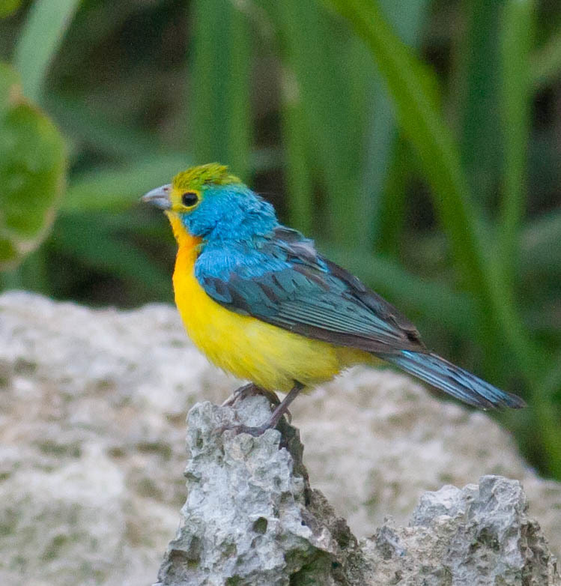
Our Story!
Determine relationship between life variables.
Infer survival style of bird family.
Interactive Bird App!
Notes:
What do we want to call our app? These descriptions are tentative and placeholders for what we decide on during Sunday’s meeting.

Slide 4
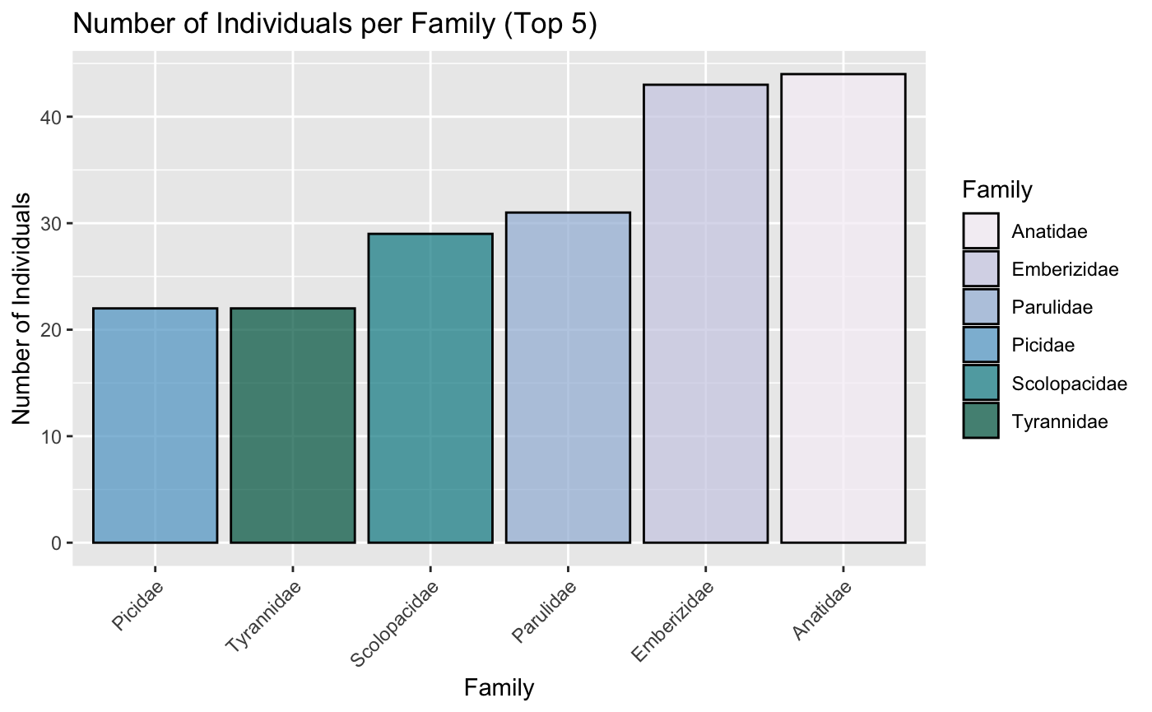
Top 5 Winter Bird Families
Given the large number of bird families present, we only used the top 5 most abundant recorded bird families.

Slide 5
Emberizidae Family
Then we filtered to just one family that fit our data analysis needs !

Slide 6
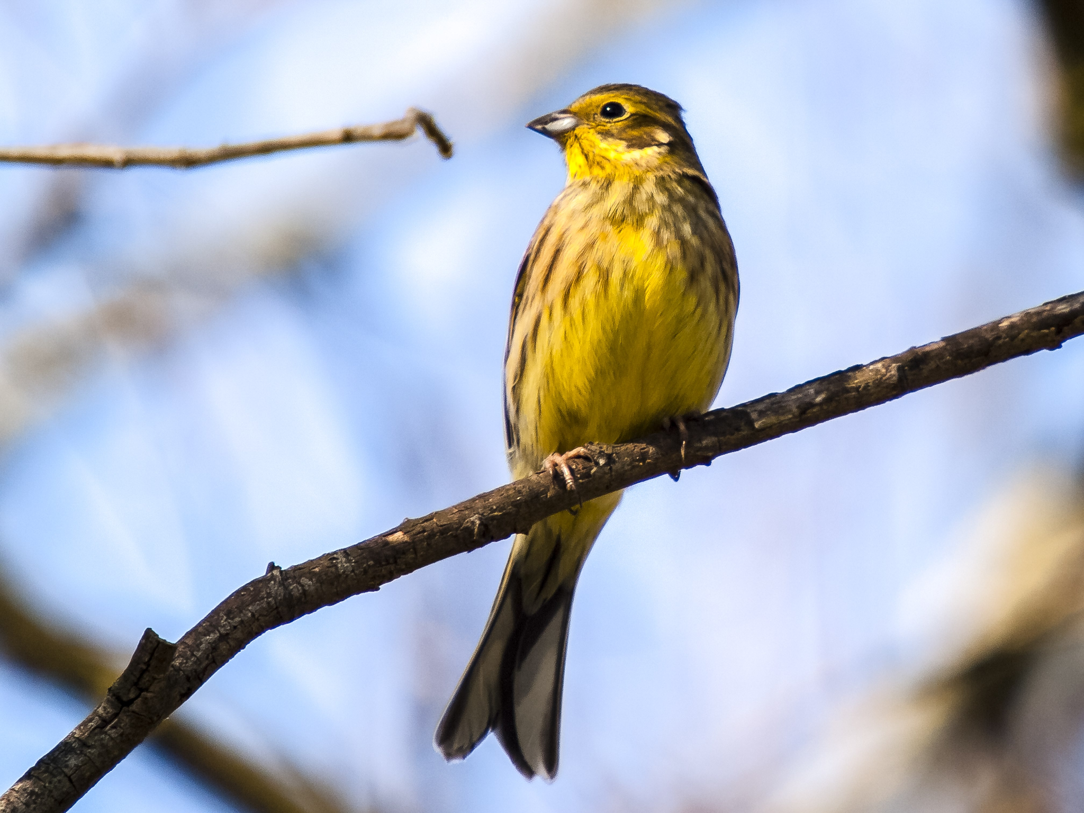
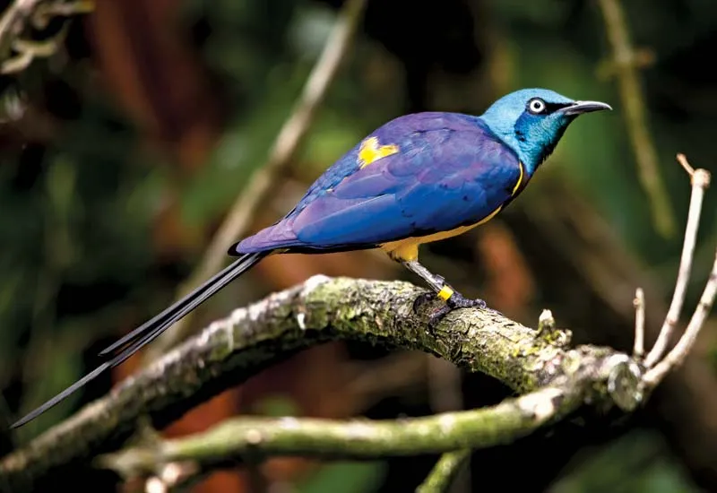
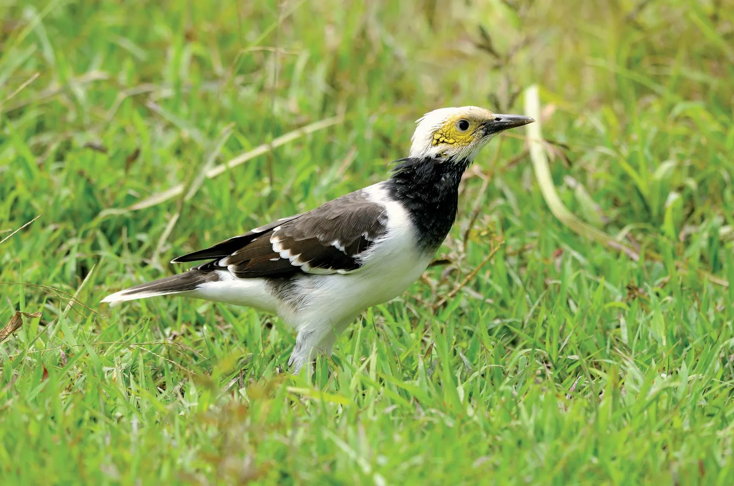
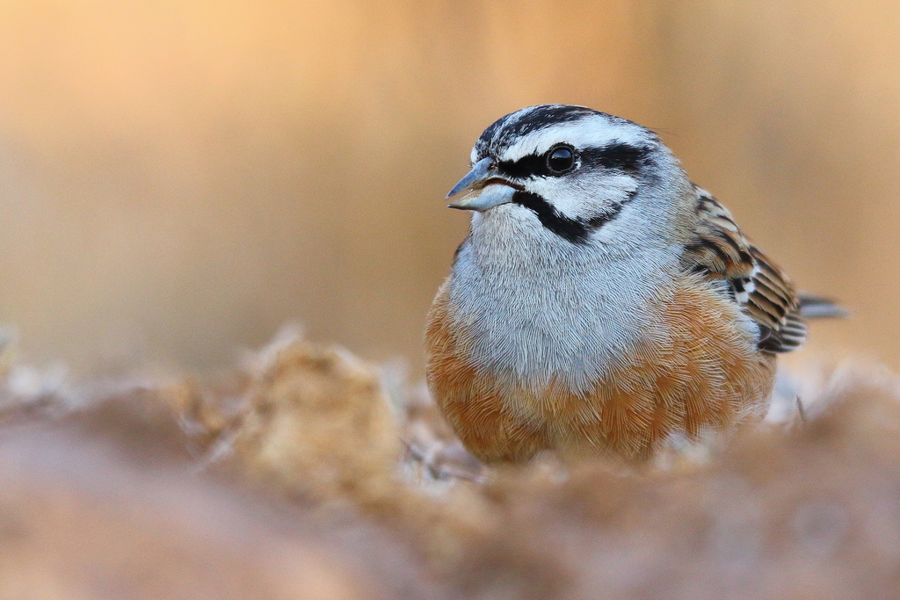
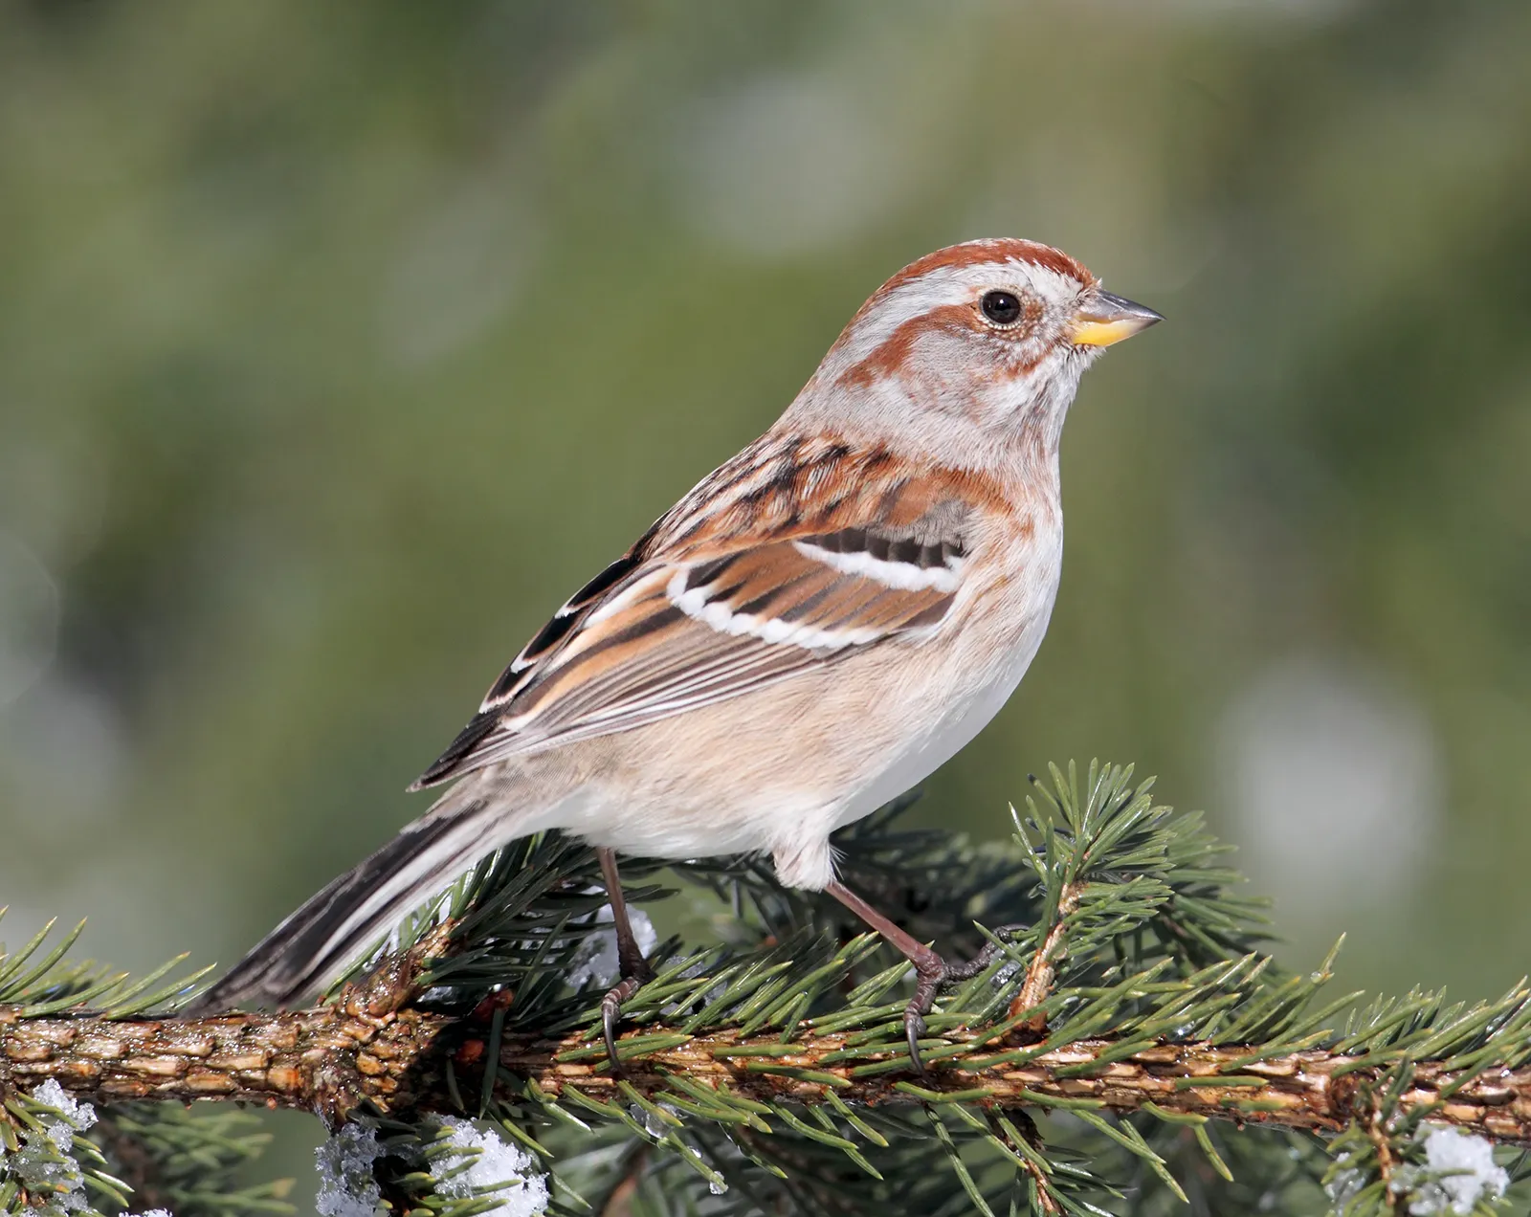
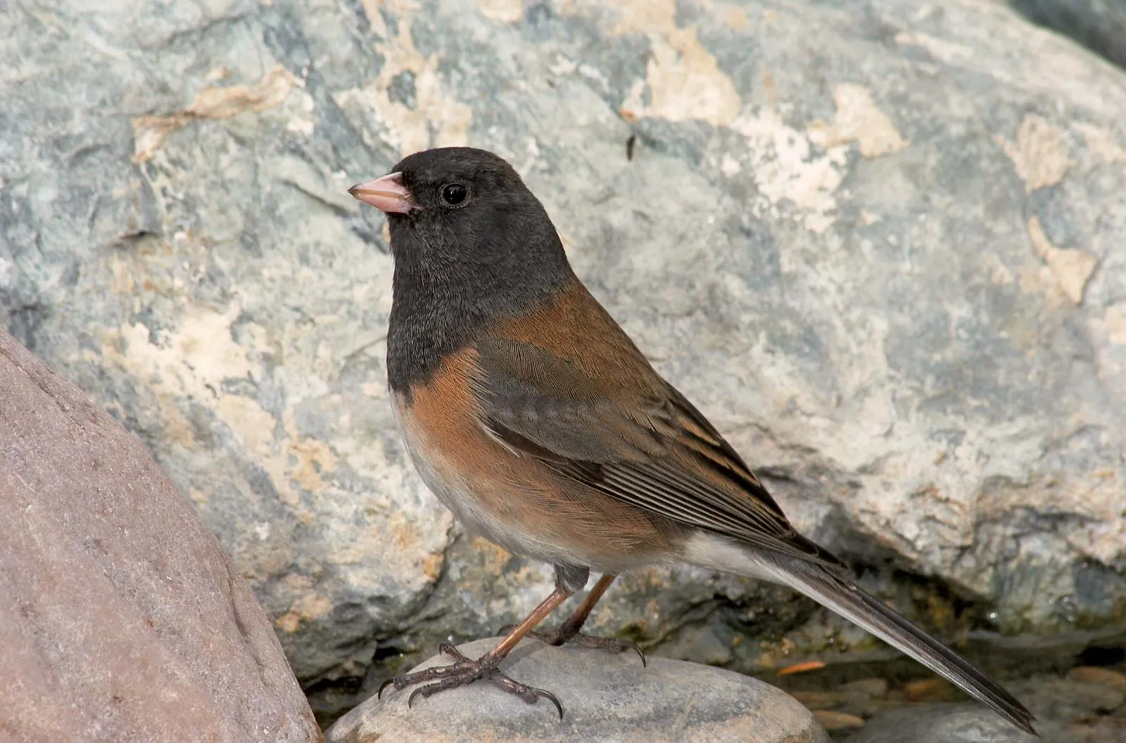
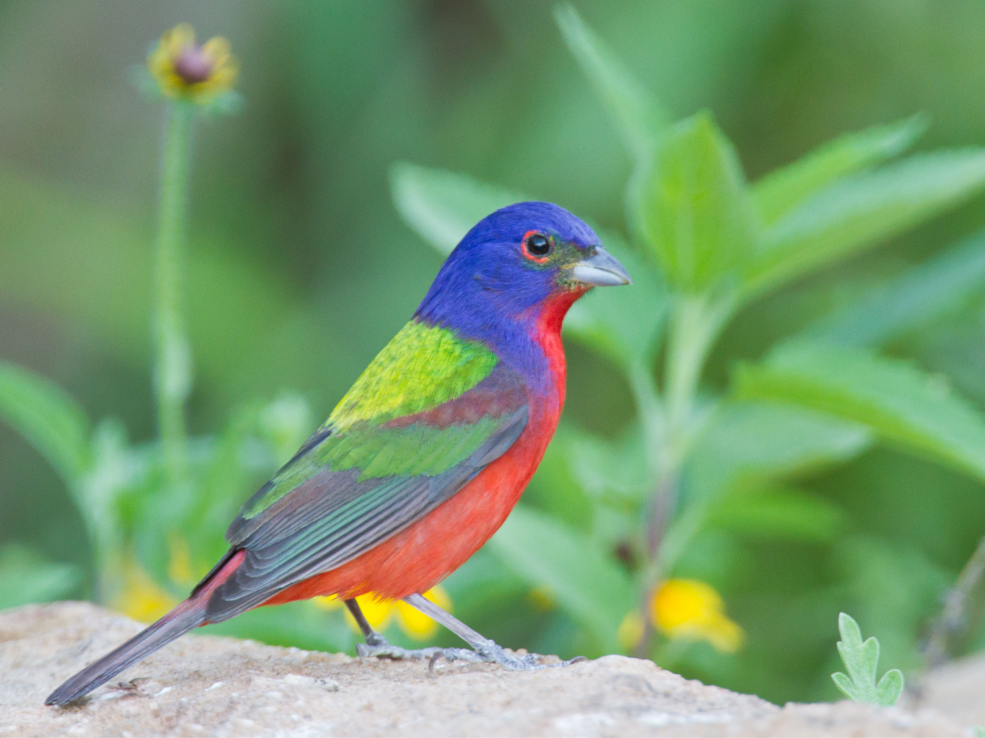
The Emberizidae Family- the songbird family!
“Families” include several “genera” (which then include several “species”). These images are only a glimpse of all the birds studied in our data!

Slide 7
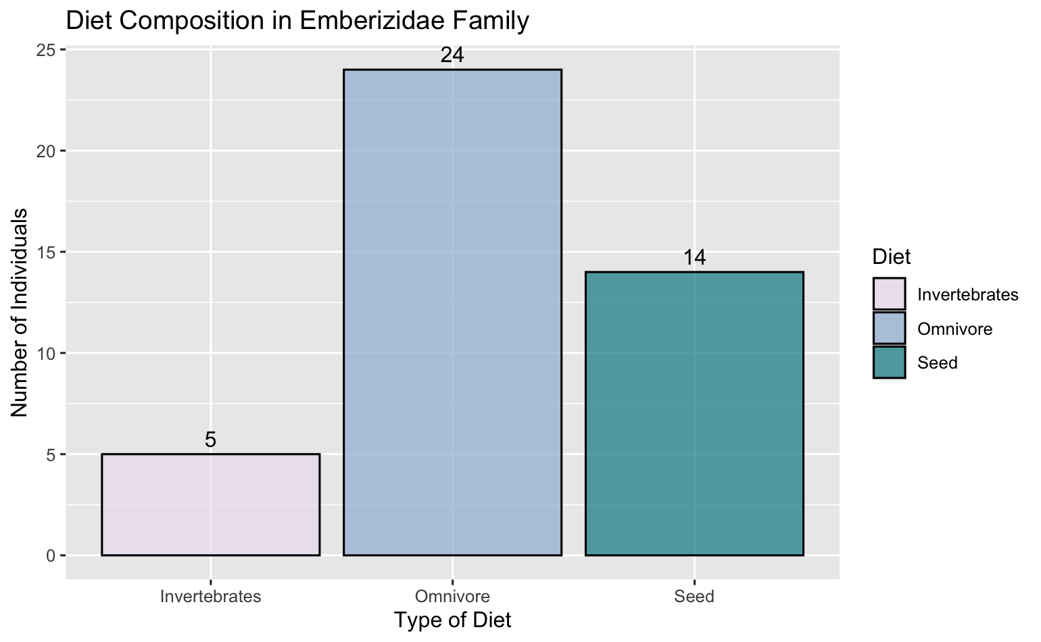
Diet Composition of Emberizidae Family
Most abundant diets:
Invertebrates
Omnivores
Vertebrates

Slide 8
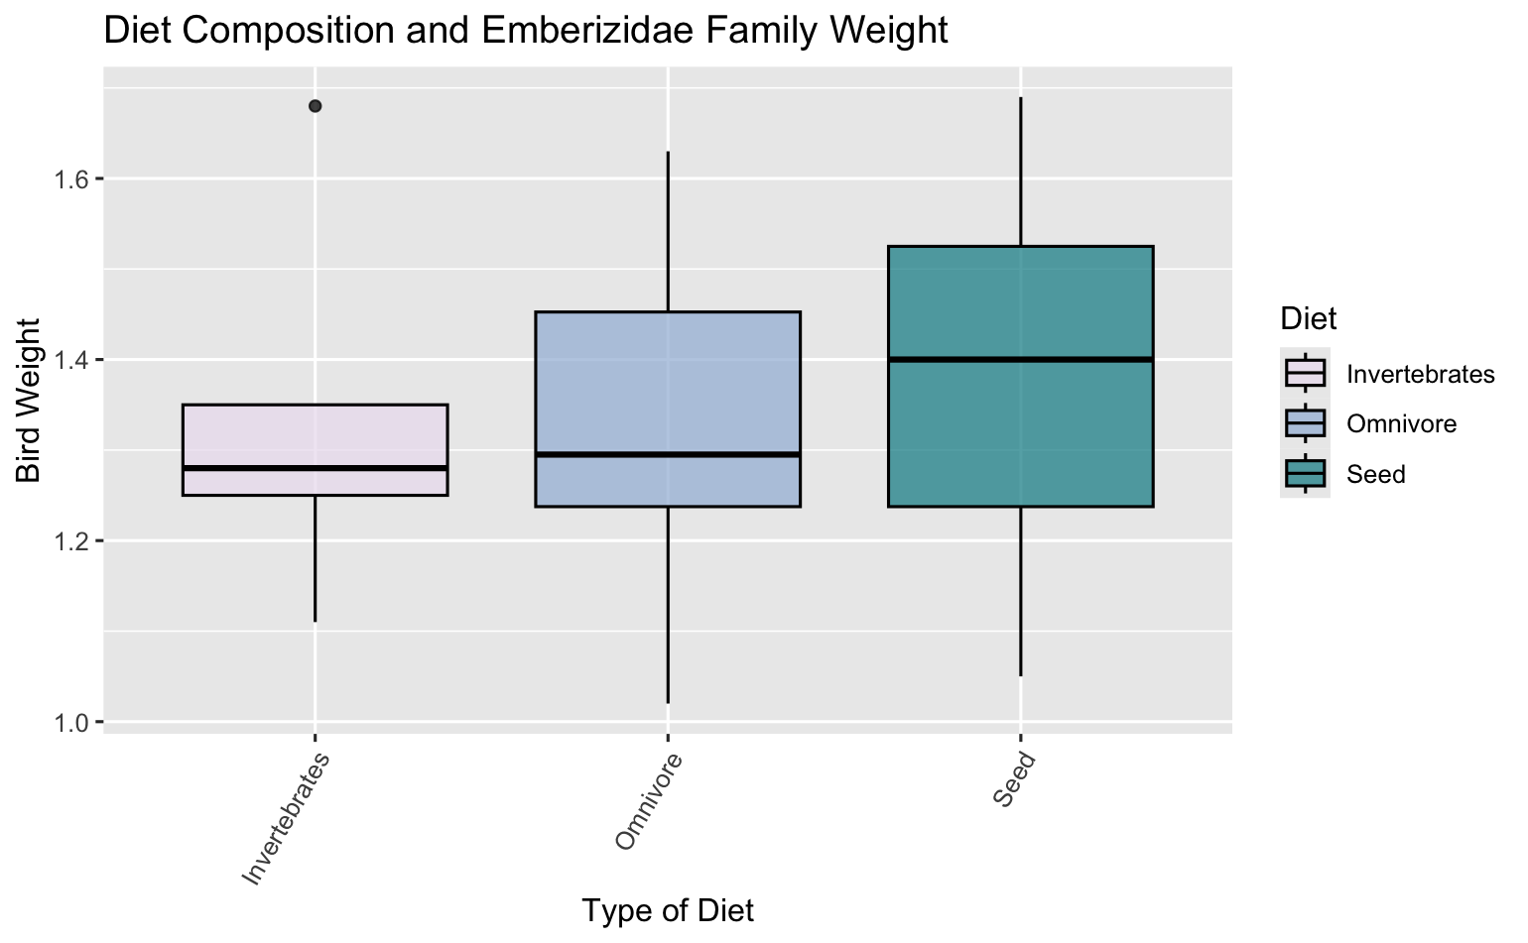
Diet Composition of Emberizidae Family*
In the Emberizidae family:
Mean bird weights:
Invertebrates: 1.33g
Omnivore: 1.32g
Seed: 1.67g
Notes:
Authors make note in the paper that the birds most prone to extinction events are those with the largest body weight.

Slide 9
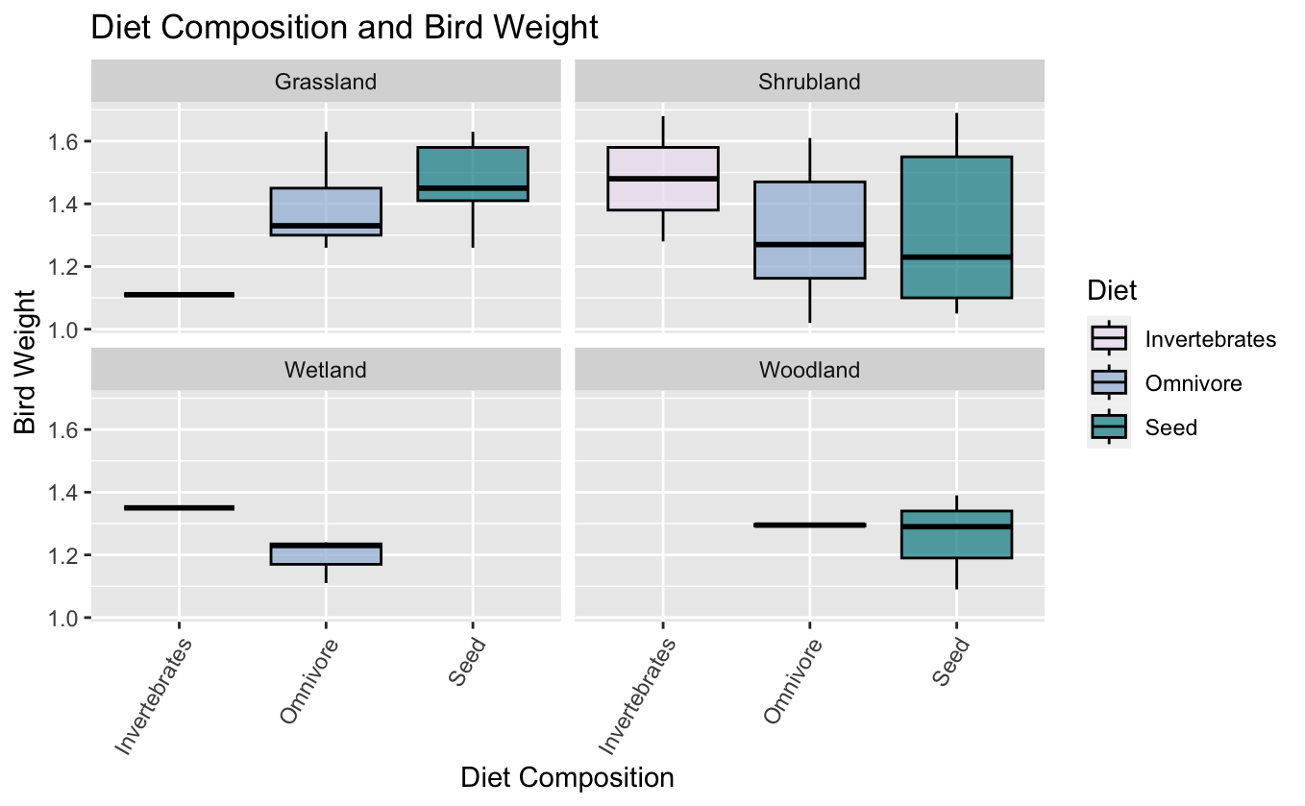
Diet Composition of Emberizidae Family
Members of the Emberizidae family do best in shrublands!
Body weight is largest in the shrublands, let’s find out why!
Notes:
In this last graph, I show that families vary in their diet composition. But this is likely also due to the habitat they live in, I think this would be a good transition point to talk about our habitat information

Slide 10
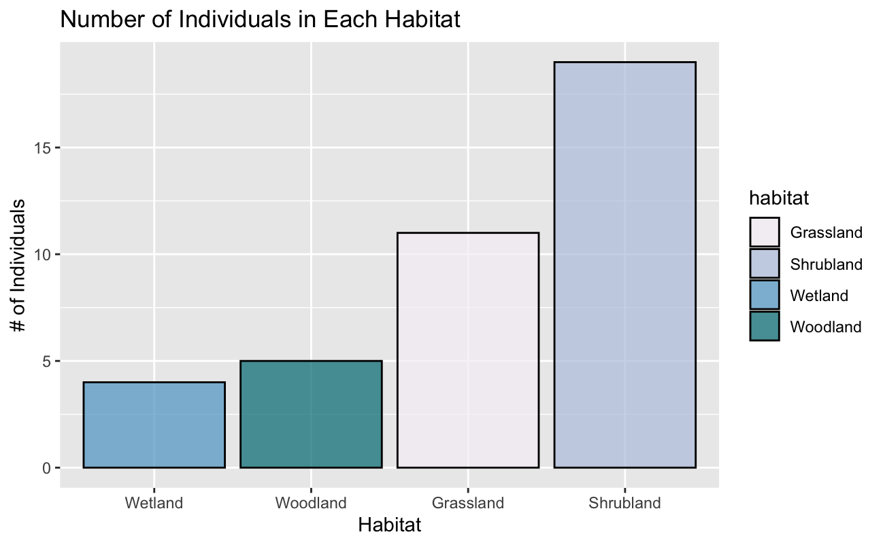
Emberizidae Family are More Abundant in Shrubland Habitat*
The body weight is greatest in the Shrubland because they are most abundant in this habitat!

Slide 11
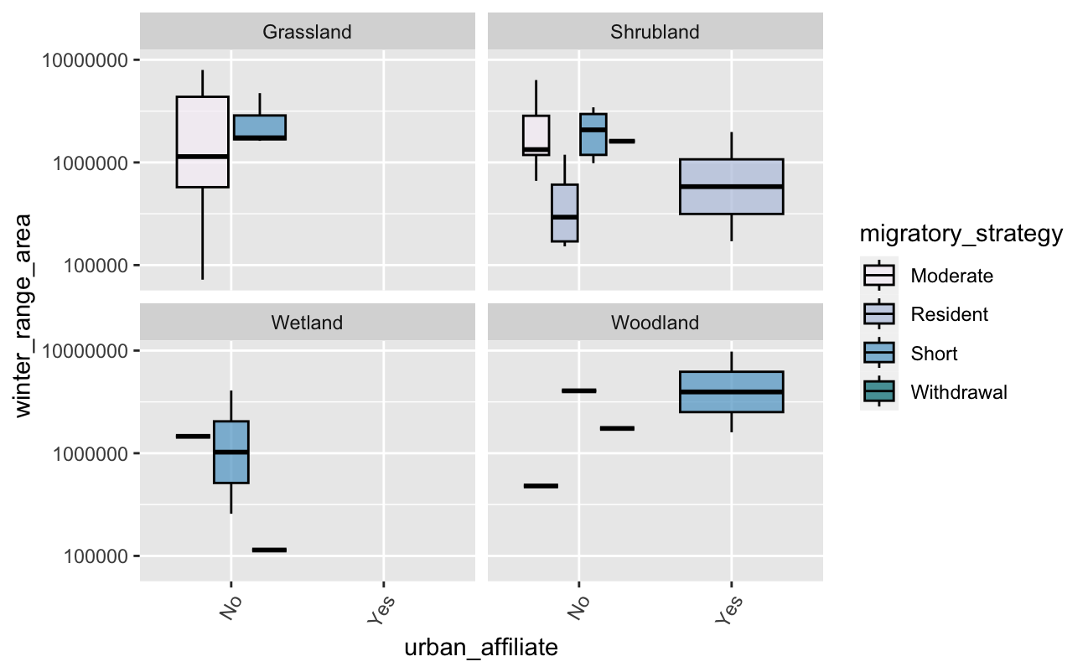
Comparison Between Habitat, Winter Range, and Migratory Strategy *
Looking at different variables we saw urbanization only in Shrubland and Woodland.

Slide 12
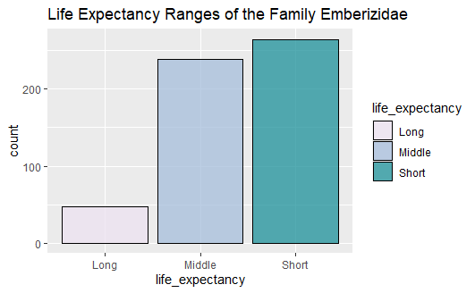
Life Expectancy of Emberizidae*
From this graph we see that, the family Emberizidae have a short-middle life expectancy.
Notes:
Most of the birds in the Emberiziae family have a short/ middle life expectancy. This means that they ultimately live between 10-20 years.

Slide 13
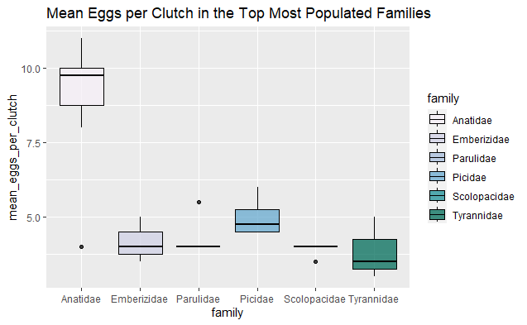
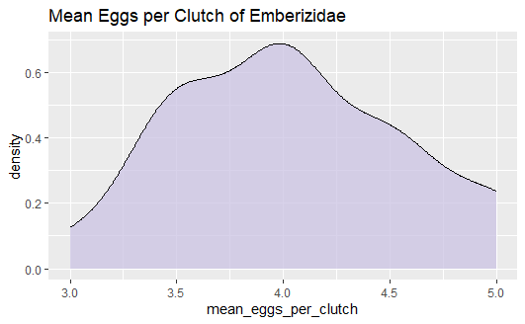
Reproduction: Mean Eggs per Clutch*
Emberizidae birds have a range of about 3-5 eggs per clutch.
Notes:
Using the other top 5 most populated Winter Birds Family to compare to the mean eggs per clutch in the Emberizidae family. We see that their mean of eggs per clutch ranges around 4-5 eggs. Based off of this graph and their life expectancy, we see that they are a mixture of R/K selected species. Since they live such short lives, they produce 4-5 eggs per clutch, but not any more than that because they have to provide parental care which can be energetically and resourceful exhausting. But they also cannot produce any less than 3 eggs because they will doom their species into extinction.

Slide 14
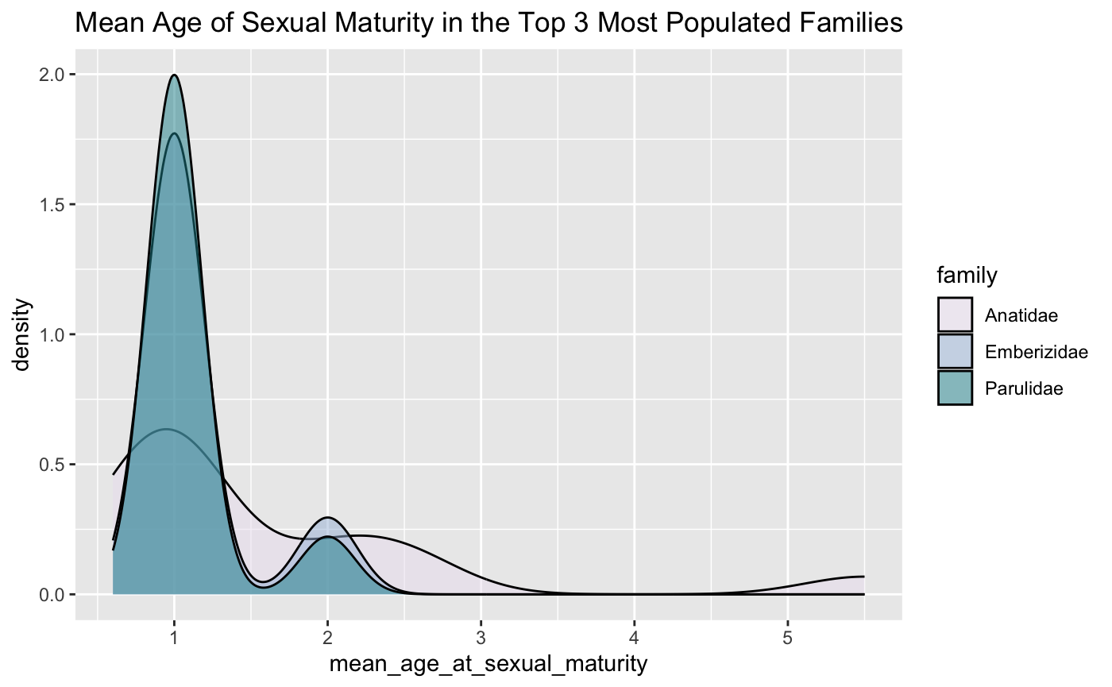
Reproduction: Age of Sexual Maturity
Emberizidae song birds sexual maturity peaking around the age of 1 and 2

Slide 15
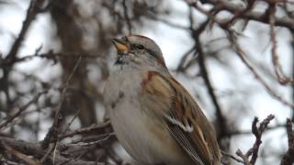
Emberizidae Survival Style
Omnivores
Most abundant in shrubland
Adapting to humans
Short life expectancy (mixed)
Average egg clutch size 3-4
Sexual maturity peaks ~1 to 2 years old

Slide 16

Our App!

